Slide 1
Software Testing

Slide 2
What Is Software
Software is set of instruction executed by a computer to perform a particular task.
A piece of code created to achieve certain functionality.

Slide 3
Types of Software
Software is a set of programs, which is designed to perform a well-defined function. A program is a sequence of instructions written to solve a particular problem.
There are two types of software
System Software
Application Software

Slide 4
System Software
The system software is collection of programs designed to operate, control, and extend the processing capabilities of the computer itself. System software are generally prepared by computer manufactures. These software products comprise of programs written in low-level languages which interact with the hardware at a very basic level. System software serves as the interface between hardware and the end users.
Some examples of system software are Operating System, Compilers, Interpreter, Assemblers etc.

Slide 5
Application Software
Application software products are designed to satisfy a particular need of a particular environment. All software applications prepared in the computer lab can come under the category of Application software.
Application software may consist of a single program, such as a Microsoft's notepad for writing and editing simple text. It may also consist of a collection of programs, often called a software package, which work together to accomplish a task, such as a spreadsheet package.

Slide 6
Domain
Domain is nothing but the subject area in which you project belongs to. It may be banking, finance, sales, health, media, telecom, Insurance, Medical, Advertising, Travel, etc.
This is important for a tester because one should know what are the user requirements say in banking, working procedures, commerce background, exposure to brokerage etc and should test application accordingly, then only you can say that your testing is enough because then you have covered scenarios from user perspective.

Slide 7
Domain
Key Business Area
1. Data Entry Input
2. Data Manipulation
3. Data Storage

Slide 8
Technology
What PL is used
What DB is used
software technology A general term covering the development methods, programming languages, and tools to support them that may be used in the development of software.

Slide 9
Platforms
In IT, a platform is any hardware or software used to host an application or service. An application platform, for example, consists of hardware, an operating system and coordinating programs that use the instruction set for a particular processor or microprocessor. In this case, the platform creates a foundation that ensures object code will execute successfully.

Slide 10
Importance of Testing
1. To discover defects. 2. To avoid user detecting problems 3. To prove that the software has no faults 4. To learn about the reliability of the software. 5. To avoid being sued by customers 6. To ensure that product works as user expected. 7. To stay in business 8. To detect defects early, which helps in reducing the cost of defect fixing?

Slide 11
Objective of Testing
The fundamental objective of testing is to find the defect as early as possible to get them fixed.
Hunt for a bug from the code at earliest phase and in shortest possible time.
It is a tester skill to write the pin pointed test cases which will dig out the hidden defects from software.

Slide 12
Objective of Testing
Demonstration of Software
Detection of Defects
Get them fixed
To maintain quality

Slide 13
Defect
When actual result deviates from the expected result while testing a software application or product then it results into a defect. Hence, any deviation from the specification mentioned in the product functional specification document is a defect. In different organizations it’s called differently like bug, issue, incidents or problem.

Slide 14
Defect is nothing but the variance between actual and expected result.
Something that is not working according to requirement is called defects.

Slide 15
Defects
Extra Missing Wrong

Slide 16
Bug
A software bug is the common term used to describe an error, mistake, failure or fault in a computer program.

Slide 17
Special Defects
Showstopper
Latent
Masked

Slide 18
Showstopper
A defect that does not allow continuing further testing is called the showstopper defects

Slide 19
Latent Bug
Is a bug which gets unobserved in two or more releases of the application .
A latent defects is an existing defect that has not yet caused a failure because the sets of conditions were never met.

Slide 20
Masked Defect
Is an existing defect that has not yet caused a failure just because another defect has prevented that part of the code from being executed.

Slide 21
Why Testing is Necessary
There are several reasons which clearly tells us as why Software Testing is important and what are the major things that we should consider while testing of any product or application.

Slide 22
Software testing is very important because of the following reasons:
1.Software testing is really required to point out the defects and errors that were made during the development phases.
2.It’s essential since it makes sure of the Customer’s reliability and their satisfaction in the application.
3.It is very important to ensure the Quality of the product. Quality product delivered to the customers helps in gaining their confidence. (Know more about Software Quality)

Slide 23
4.Testing is necessary in order to provide the facilities to the customers like the delivery of high quality product or software application which requires lower maintenance cost and hence results into more accurate, consistent and reliable results.
5.Testing is required for an effective performance of software application or product.
6.It’s important to ensure that the application should not result into any failures because it can be very expensive in the future or in the later stages of the development.
7.It’s required to stay in the business.

Slide 24
Causes of Software Defects
Miscommunication of requirements introduces error in code
Unrealistic time schedule for development
Lack of designing experience
Lack of coding practices experience
Human factors introduces errors in code
Lack of version control
Buggy third-party tools
Last minute changes in the requirement introduce error
Poor Software testing skill

Slide 25
1) Miscommunication of requirements introduces error in code:
Miscommunication of the requirements is one the most common problem in the software development process which causes an introduction of defects in the code. It means erroneous & lack of communication in the software development process. This may introduce from the first step of SDLC means from requirement gathering to development of the product. If the requirements are incomplete or vague then the development leads to situation where developers facing in developing software application based on incomplete requirements and this cause the issue in testing of such incomplete application. Also communication errors are introduced in case if application developed by other developer & modified by other developer.

Slide 26
2) Unrealistic time schedule for development:
In the fast moving world Stakeholders want new things implemented before the competitors implement it. So to develop and QAed the application in unrealistic project deadlines make impact in the quality of the project & cause to introduce the defects in the application. It should not be developed under crazy release schedules with the insufficient or limited resources create bad impact. Many of the times developers not get enough time to design, develop & unit tested the application in dev environment prior to move to tester’s plate to test complete application. So more likely the last minutes change made could introduce errors in the code.

Slide 27
3) Lack of designing experience:
To start with development the main core part of development is design & how good your design is decides the overall software application development. In the current age of complex software development market either implementation is complex or to implement the project more research & development required. Sometimes it also complicated to understand the problems. Sometimes they have to complete the project in a specific time period, so doing design, development & testing in specific period time set may cause the errors.

Slide 28
4) Lack of coding practices experience:
Coding plays an important role in Software development process. Simply bad coding leads to errors into code. Bad coding means unhandled exceptions, errors, improper validations of inputs. Few programmers are working with bad tools like faulty debuggers, compliers, validators etc., using this is about to add errors in the code due to tricky to debug the code.

Slide 29
5) Human factors introduces errors in code:
Most common area to get defects introduced in the code is the “Human Errors” this is because of the system is developed by the human being & they are not perfect all the time. As system is developed by the human so we cannot expect the system would be bug free, hence this is the one area from where the errors might be introduced in the system. If paradoxically the we are yet to find out the non-human who can develop the software for us. So we have to rely on the human being to develop the software.

Slide 30
6) Lack of version control:
If the functionality was tested in previous builds & after next few build it is seeing that regression errors occurs so it is very difficult to identify the regression errors. So in such a case version controlling makes a key role. Even if a version control system (e.g. Visual SourceSafe) is in place, errors might still slip into the final builds if the programmers fail to make sure that the most recent version of each module are linked when a new version is being built to be tested.

Slide 31
7) Buggy third-party tools:
Most of the time we have to use Third party tools in software development process. These are open source tools or commercial tools based on project requirement. Tools like Complier, Debugger, HTML Editors, plug-ins, external APIs, class libraries, Shared DLLs are developed by someone else & might have bugs in the tools which adding error in our software.

Slide 32
8) Last minute changes in the requirement introduce error:
Requirements changes in the last minute can be dangerous which results instability of software application. To implement the changes which are introduced in 11th hour requirement changes will definitely introduce errors in the application & also existing working feature may stop working.

Slide 33
9) Poor Software testing skill:
In many organizations poor testing can be executed, this would not like to see by any tester but let’s face it. There can be insufficient knowledge of testing skills (Lack of skilled testing) which leads to defects in the system. Also if tester is not paying attention in testing activity & doing testing without giving importance to it, so it results poor quality of the product & major bugs remains in the software. Moreover, in this era of agile software development poor unit tests (e.g. in TDD) may result in poor coding and hence escalate the risk of errors.

Slide 34
Role of Software Testing in Software Development
Testing is an infinite process of comparing the invisible to the ambiguous in order to avoid the unthinkable happening to the anonymous.” –James Bach

Slide 35
Testing plays a vital role in software development. In every company, testing is an important and valuable stage in the Software Development Life Cycle. Techniques used for software testing differ from one company to another. Software testing is not an easy task. Each and every day there will be challenges in coding as well as decoding.

Slide 36
Improve Your Software
The role of testing in software development begins with improved reliability, quality and performance of the software. It assists a developer to check out whether the software is performing the right way and to assure that software is not performing what it is not supposed to do.

Slide 37
Testing can be done in two ways: manual testing and automated testing. Manual testing is done by human testers who check codes and bugs in software manually. On the other hand, automated testing is the process of using computer programs to execute a system.
Automated testing requires special software such as LoadRunner and WinRunner. There are several tools available for software testing in the internet. It is essential to assure that each unit works as desired. If bugs are found at the initial level, the developer can create an accurate and reliable software.

Slide 38
Quality assurance
Quality plays a vital role in today’s competitive world. Hence a software tester plays key role in Software Development Life Cycle for producing quality products.
Testing will be necessary for making the software defect free. Defects can be identified and rectified. Automated testing offers a great help to create defect free software.
Testing forms an integral part in the Software Development Life Cycle for improving consistency and performance of software. Testing stages have a lot of significance in software development life cycle as it is having a great part in executing and fault rectification.
Software testing services help the developer to know the difference between actual and expected outcome which help to improve quality of product.

Slide 39
Helps to avoid dangerous situations
Without proper testing, produced software can be dangerous to the users. They will be confused and lose credibility towards that particular software.
A good and effective software testing helps to improve security. Authentication and validation are the main aim of software testing services. Basically, a software testing helps not only to discover defects in software, but also its configuration. Through testing, developers are able to determine the reliability of the software. Any product can be turned into a strong and consistent product with the help of testing in software development. Accurate and consistent testing make the business successful and builds goodwill for the company.

Slide 40
How Much Testing Is Enough?
Testing everything (all combinations of inputs and preconditions) is not feasible except for trivial cases. Instead of exhaustive testing, we use risks and priorities to focus testing efforts. Exhaustive testing (complete testing) A test approach in which the test suite comprises all combinations of input values and preconditions. We've seen that testing helps us find defects and improve software quality. How much testing should we do? We have a choice: test everything, test nothing or test some of the software. Now, your immediate response to that may well be to say, 'Everything must be tested'. We don't want to use software that has not been completely tested, do we? This implies that we must exercise every aspect of a software system during testing. What we need to consider is whether we must, or even can, test completely.

Slide 41
Let's look at how much testing we'd need to do to be able to test exhaustively. How many tests would you need to do to completely test a one-digit numeric field? The immediate question is, 'What you mean by test completely?' There are 10 possible valid numeric values but as well as the valid values we need to ensure that all the invalid values are rejected. There are 26 uppercase alpha characters, 26 lower case, at least 6 special and punctuation characters as well as a blank value. So there would be at least 68 tests for this example of a one-digit field. This problem just gets worse as we look at more realistic examples. In practice, systems have more than one input field with the fields being of varying sizes

Slide 42
These tests would be alongside others such as running the tests in different environments. If we take an example where one screen has 15 input fields, each having 5 possible values, then to test all of the valid input value combinations you would need 30 517 578 125 (515) tests! It is unlikely that the project timescales would allow for this number of tests. Testing our one-digit field with values 2, 3 and 4 makes our tests more thorough, but it does not give us more information than if we had just tested with the value 3.

Slide 43
Pressures on a project include time and budget as well as pressure to deliver a technical solution that meets the customers' needs. Customers and project managers will want to spend an amount on testing that provides a return on investment for them. This return on investment includes preventing failures after release that are costly. Testing completely - even if that is what customers and project managers ask for - is simply not what they can afford.

Slide 44
Instead we need a test approach which provides the right amount of testing for this project, these customers (and other stakeholders) and this software. We do this by aligning the testing we do with the risks for the customers, the stakeholders, the project and the software. Assessing and managing risk is one of the most important activities in any project, and is a key activity and reason for testing. Deciding how much testing is enough should take account of the level of risk, including technical and business risks related to the product and project constraints such as time and budget.

Slide 45
We carry out a risk assessment to decide how much testing to do. We can then vary the testing effort based on the level of risk in different areas. Additionally, testing should provide sufficient information to stakeholders to make informed decisions about the release of the software or system we're testing, for the next development step or handover to customers. The effort put into the quality assurance and testing activities needs to be tailored to the risks and costs associated with the project. Because of the limits in the budget, the time, and in testing we need to decide how we will focus our testing, based on the risks.

Slide 46
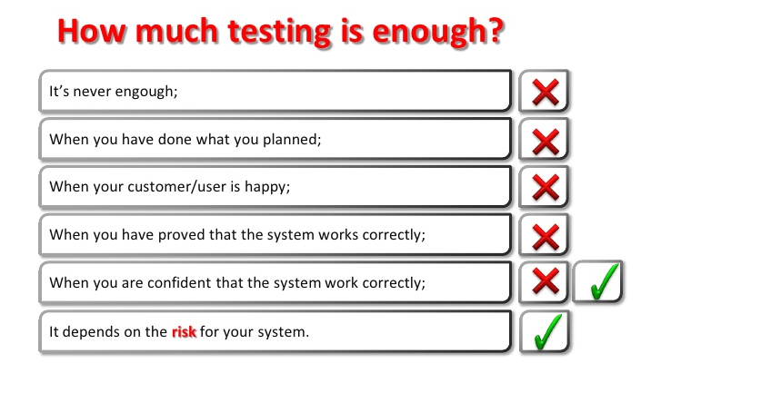

Slide 47
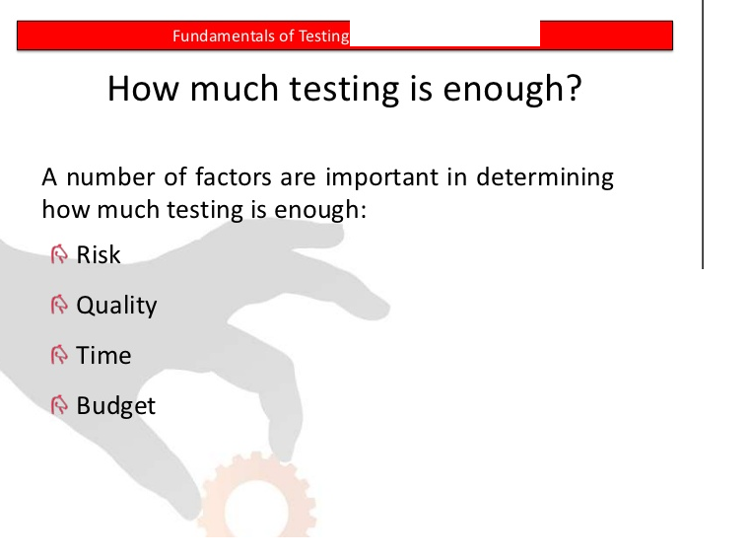

Slide 48
The Psychology of Testing!
A software tester is any human being who tests the software. So, what do you answer if anybody asks you 'Does software testing need a specialized skill'? It looks very simple to answer this question, isn't it? But of course not. Software Testing is not as easy as you might think of. Needless to say, It's one of the most important and difficult tasks in the entire gamut of software development life cycle process. Nevertheless, the quality of the job done by the software tester is directly proportional to his or her psychological maturity and profoundness acquired, adopted and developed with age and experience.

Slide 49
Role & Characteristics of a Software Tester
Software Development & Software Testing go hand in hand. Both aim at meeting the predefined requirements and purpose. Both are highly creative jobs in nature but the general outlook towards these two individuals is psychological rather than distinctive classification.

Slide 50
Software Testers require technical skills similar to their development counterparts, but software testers need to acquire other skills, as well.
Keen Observation
Detective Skills
Destructive Creativity
Understanding Product as integration of its parts
Customer Oriented Perspective
Cynical but Affable Attitude
Organized, Flexible & Patience at job
Objective & Neutral attitude

Slide 51
Keen Observation – The software tester must possess the qualities of an 'eye for detail'. A keen observation is the prime quality any software tester must possess. Not all bugs are visible clearly to the naked eye in a software. With keen observation, the tester can easily identify or detect many critical bugs. Observing the software for established parameters like 'look & feel' of GUI, incorrect data representation, user friendliness etc needs this type of characteristics.

Slide 52
Detective Skills – Ideally the software under development would be documented before, after and throughout the development process. Unfortunately, there is every chance of not updating the documentation (specification, defect reports etc) due to time and resource constraints. tester should therefore possess the quality of a 'detective' to explore the product under test, more rationally.

Slide 53
Destructive Creativity – The Tester need to develop destructive skills – means skills to perturb and crash the software workflow and its functionality. In other words, the tester should 'not hesitate to break the software' fearing to buy it or being empathetic to the creation of developers. In software testing, boundaries are meant to be crossed not obeyed.
A creative oriented but destructive approach is necessary while testing a software by the tester to make the software evolve more robustly and reliably.

Slide 54
Understanding the Product as an integration of its parts – The software(read as product) is a culmination of lines of code interacting with data through user interface and database.
It is an integration of separate group of code interacting with other groups assembled together to function as a whole product. The developers might be working on a respective piece of code module focusing more on those modules under work, at a time.

Slide 55
Organized, Flexible and Patience at Job: Software testers must remember the fact that as the world is shrinking since the advent of internet and web, so, change is very dynamic and no exception for modern software. Not all the tests planned are performed completely and some tests dependent on other tests has to be blocked for later testing.
This needs an organized approach by the tester in attempting to phase out the bugs. Sometimes, significant tests has to be rerun which would change the fundamental functionality of the software. The tester should therefore have patience to retest the planned bugs and any new bugs that may arise.

Slide 56
Objective and Neutral Attitude – Nobody would like to hear and believe bad news, right? Well, testers are sometimes viewed as messengers of bad news in a software project team. No wonder, how good the tester is (meaning very negative) and brilliant in doing his job (identifying bugs-no one likes to do it but most human beings are taken for granted to be naturally very good at it, at least from childhood), he/she might always be a messenger of communicating the bad part of the software, which, the creators (developers) doesn't like it.
"Nobody who builds the houses likes to have them burned."

Slide 57
Testers must adhere to a code of ethics: they are required to act in a professional manner. Testers can have access to confidential and/or privileged information, and they are to treat any information with care and attention, and act responsibly to the owner(s) of this information, employers and the wider public interest. Of course, anyone can test software, so the declaration of this code of conduct applies to those who have achieved software testing certification! The code of ethics applies to the following areas: Public—Certified software testers shall consider the wider public interest in their actions.
Client and employer—Certified software testers shall act in the best interests of their client and employer (being consistent with the wider public interest).
Product—Certified software testers shall ensure that the deliverables they provide (for any products and systems they work on) meet the highest professional standards possible.
Management—Certified software test managers and leaders shall subscribe to and promote and ethical approach to the management of software testing.
Profession—Certified software testers shall advance the integrity and reputation of the profession consistent with the public interest.
Colleagues—Certified software testers shall be fair to and supportive of their colleagues, and promote cooperation with software developers.
Self—Certified software testers shall participate in lifelong learning regarding the practice of their profession, and shall promote an ethical approach to the practice of the profession.

Slide 58
code of ethics
Testers must adhere to a : they are required to act in a professional manner. Testers can have access to confidential and/or privileged information, and they are to treat any information with care and attention, and act responsibly to the owner(s) of this information, employers and the wider public interest. Of course, anyone can test software, so the declaration of this code of conduct applies to those who have achieved software testing certification! The code of ethics applies to the following areas:

Slide 59
Public—Certified software testers shall consider the wider public interest in their actions.
Client and employer—Certified software testers shall act in the best interests of their client and employer (being consistent with the wider public interest).
Product—Certified software testers shall ensure that the deliverables they provide (for any products and systems they work on) meet the highest professional standards possible.
Judgement—Certified software testers shall maintain integrity and independence in their professional judgement.
Management—Certified software test managers and leaders shall subscribe to and promote and ethical approach to the management of software testing.
Profession—Certified software testers shall advance the integrity and reputation of the profession consistent with the public interest.
Colleagues—Certified software testers shall be fair to and supportive of their colleagues, and promote cooperation with software developers.
Self—Certified software testers shall participate in lifelong learning regarding the practice of their profession, and shall promote an ethical approach to the practice of the profession.

Slide 60
Software Testing Principles

Slide 61
It is important that you achieve an optimum test results while conducting software testing without deviating from the goal. But how you determine that you are following right strategy for testing? For that, you need to stick to some basic testing principles. Here are the common seven testing principles that are widely practiced in the software industry.
To understand this, consider a scenario where you are moving a file from folder A to Folder B.
Think of all the possible ways you can test this.

Slide 62
Apart from the usual scenarios, you can also test the following conditions
Trying to move the file when it is Open
You do not have the security rights to paste the file in Folder B
Folder B is on a shared drive and storage capacity is full.
Folder B already has a file with the same name, infact the list is endless
Or suppose you have 15 input fields to test ,each having 5 possible values , the number of combinations to be tested would be 5^15
If you were to test the entire possible combinations project EXECUTION TIME & COSTS would rise exponentially. We need certain principles and strategies to optimize the testing effort

Slide 63
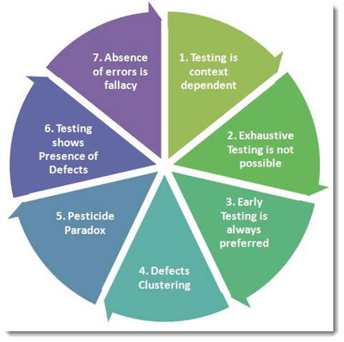

Slide 64
1.Testing Shows Presence of Defects:
Testing an application can only reveal that one or more defects exist in the application. Even after testing the application or product thoroughly we cannot say that the product is 100% defect free. Testing always reduces the number of undiscovered defects remaining in the software.Therefore, it is important to design Test Cases which find as many defects as possible.

Slide 65
2.Exhaustive Testing is Impossible:
It is not possible to test all possible combinations of data and Test Scenarios as it will take to much time. For this reason, risk and priorities are used to concentrate on the most important aspects to test. Accessing and managing risk is one of the most important activities and reason for testing in any project.

Slide 66
3.Early Testing:
In the Software Development Life Cycle testing activities should start early and focus on defined objectives. As soon as the initial products, such as requirement or design documents are available, we can start testing. By starting testing early, test can be prepared for each level of the development life-cycle. Another important point about early testing is that when defects are found earlier in the life-cycle, they are much easier and cheaper to fix. It is much cheaper to change an incorrect requirement than having to change a functionality in a large system that is not working as requested or as designed!

Slide 67
4. Defect Clustering:
During testing, it can be observed that most of the reported defects are related to small number of modules within a system. By identifying and focusing on these clusters, testers can efficiently test the sensitive areas while concurrently testing the remaining “non-sensitive” areas.

Slide 68
5.Pesticide Paradox:
If we keep running the same set of tests over and over again, chances are no more new defects will be discovered by those test cases. “Pesticide Paradox” means that it is very important to review the test cases regularly. New and different tests need to be written to cover different parts of the software or system to find more defects.

Slide 69
6.Testing is Context Depending:
The same tests should not be applied across the board because different software products have varying requirements, functions and purposes. Different methodologies, techniques and types of testing are related to the type and nature of the application. For example, a software application in a medical device software needs more testing than a games software. Also, a medical device software requires to be compliant with medical industry regulators and possibly specific test design techniques.

Slide 70
7.Absence of Errors Fallacy
If the system built is unusable and does not fulfil the user’s needs and expectations then finding and fixing defects will not help. Also if testing didn’t find any defects in the software, it doesn’t mean that the software is ready to be used. It must be confirmed wheather the executed tests were really designed to catch the most of the defects.

Slide 71
Principle 1 Testing shows presence of defects
Principle 2Exhaustive testing is impossible
Principle 3Early Testing
Principle 4Defect Clustering
Principle 5Pesticide Paradox
Principle 6Testing is context dependent
Principle 7Absence of errors - fallacy

Slide 72
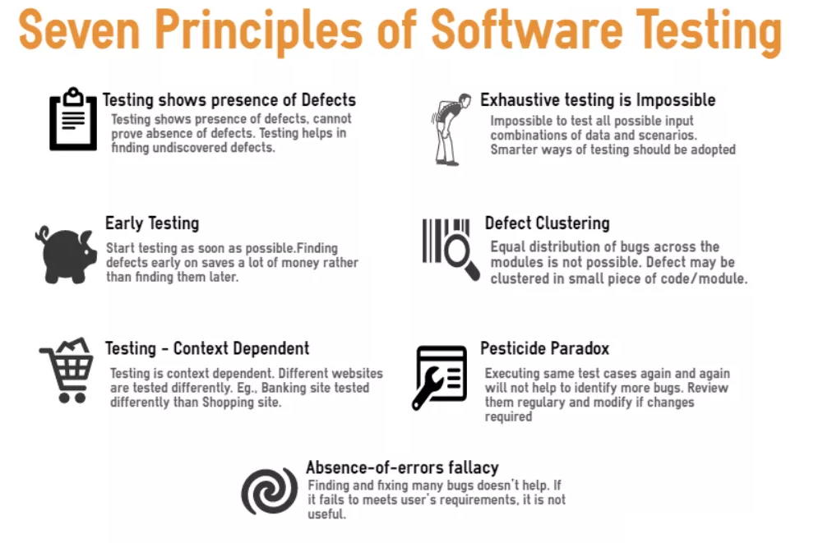

Slide 73
Software Testing Life Cycle

Slide 74
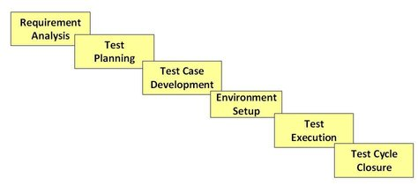
Software Testing Life Cycle

Slide 75
What is a Lifecycle?
Lifecycle in simple term refers to the sequence of changes from one form to other form. These changes can happen to any tangible or intangible things. Every entity has a lifecycle from its inception to retire / demise.
In a similar fashion, Software is also an entity. Just like developing software involves a sequences of steps, testing also has steps which should be executed in a definite sequence.
This phenomenon of executing the testing activities in a systematic and planned way is called testing life cycle.

Slide 76
What is Software Testing Life Cycle (STLC)
Software Testing Life Cycle refers to a testing process which has specific steps to be executed in a definite sequence to ensure that the quality goals have been met. In STLC process, each activity is carried out in a planned and systematic way. Each phase has different goals and deliverables. Different organizations have different phases in STLC; however the basis remains the same.

Slide 77
Below are the phases of STLC:
Requirements phase
Planning Phase
Analysis phase
Design Phase
Implementation Phase
Execution Phase
Conclusion Phase
Closure Phase

Slide 78
#1. Requirement Phase:
During this phase of STLC, analyze and study the requirements. Have brain storming sessions with other teams and try to find out whether the requirements are testable or not. This phase helps to identify the scope of the testing. If any feature is not testable, communicate it during this phase so that the mitigation strategy can be planned.
#2. Planning Phase:
In practical scenarios, Test planning is the first step of the testing process. In this phase we identify the activities and resources which would help to meet the testing objectives. During planning we also try to identify the metrics, the method of gathering and tracking those metrics.

Slide 79
#3. Analysis Phase: This STLC phase defines “WHAT” to be tested. We basically identify the test conditions through the requirements document, product risks and other test basis. The test condition should be traceable back to the requirement. There are various factors which effect the identification of test conditions:

Slide 80
– Levels and depth of testing – Complexity of the product – Product and project risks – Software development life cycle involved. – Test management – Skills and knowledge of the team. – Availability of the stakeholders.

Slide 81
#4. Design Phase:
This phase defines “HOW” to test. This phase involves the following tasks:
– Detail the test condition. Break down the test conditions into multiple sub conditions to increase coverage. – Identify and get the test data – Identify and set up the test environment. – Create the requirement traceability metrics – Create the test coverage metrics.

Slide 82
#5. Implementation Phase:
The major task in this STLC phase is of creation of the detailed test cases. Prioritize the test cases also identify which test case will become part of the regression suite. Before finalizing the test case, It is important to carry out the review to ensure the correctness of the test cases. Also don’t forget to take the sign off of the test cases before actual execution starts. If your project involves automation, identify the candidate test cases for automation and proceed for scripting the test cases. Don’t forget to review them!

Slide 83
#6. Execution Phase:
As the name suggests, this is the Software Testing Life Cycle phase where the actual execution takes place. But before you start your execution, make sure that your entry criterion is met. Execute the test cases, log defects in case of any discrepancy. Simultaneously fill your traceability metrics to track your progress.

Slide 84
#7. Conclusion Phase:
This STLC phase concentrates on the exit criteria and reporting. Depending on your project and stakeholders choice, you can decide on reporting whether you want to send out a daily report of weekly report etc. There are different types of reports ( DSR – Daily status report, WSR – Weekly status reports) which you can send, but the important point is, the content of the report changes and depends upon whom you are sending your reports.

Slide 85
#8. Closure Phase:
Tasks for the closure activities include the following:
– Check for the completion of the test. Whether all the test cases are executed or mitigated deliberately. Check there are no severity 1 defects opened. – Do lessons learnt meeting and create lessons learnt document.( Include what went well, where are the scope of improvements and what can be improved)

Slide 86
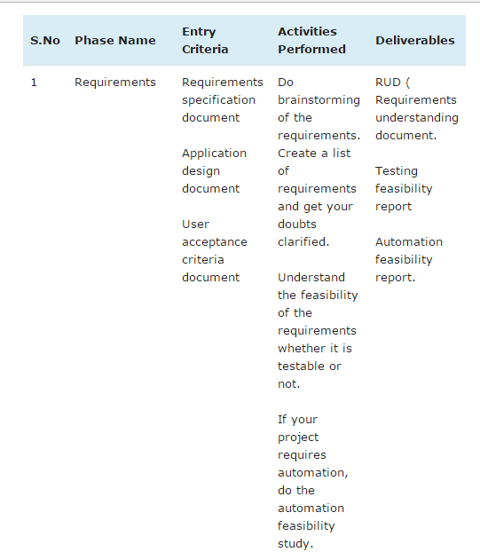

Slide 87
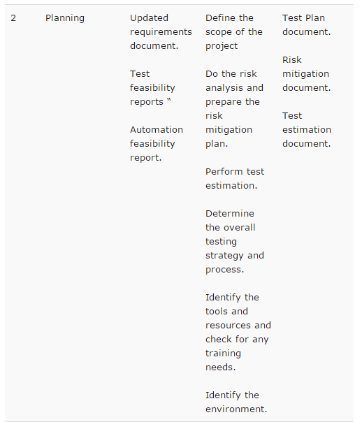

Slide 88
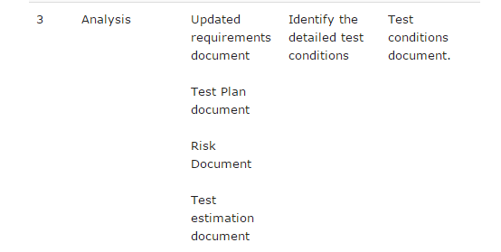

Slide 89
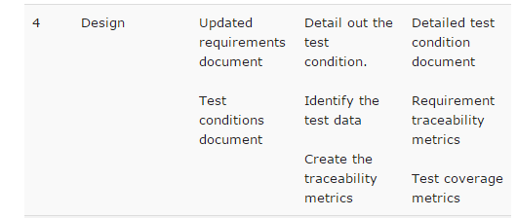

Slide 90
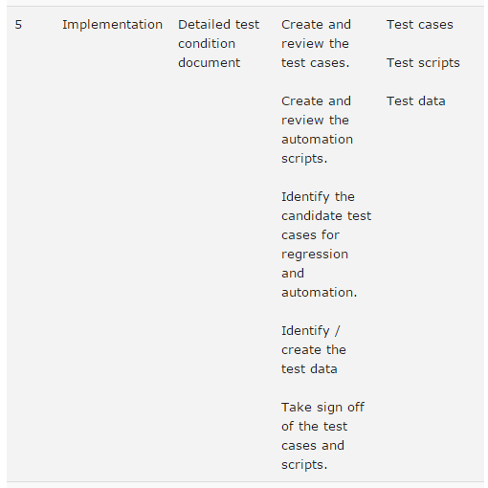

Slide 91
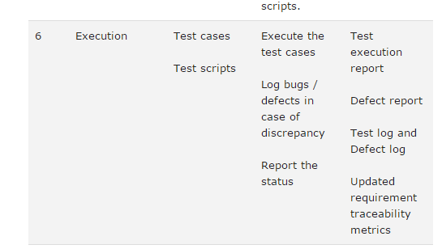

Slide 92
